Slide 1
Replication-driven Live Reconfiguration for Fast Distributed Transaction Processing
Xingda Wei, Sijie Shen, Rong Chen, Haibo Chen
Institute of Parallel and Distributed Systems Shanghai Jiao Tong University, China
Present By YJB 2019.03.15

Slide 2





Imbalance Is Common in Current Tx System
Idle
$9.3 billion/day
Busy
Nanjing
Shanghai
11.6 million payments/day
Idle
Hangzhou

Slide 3
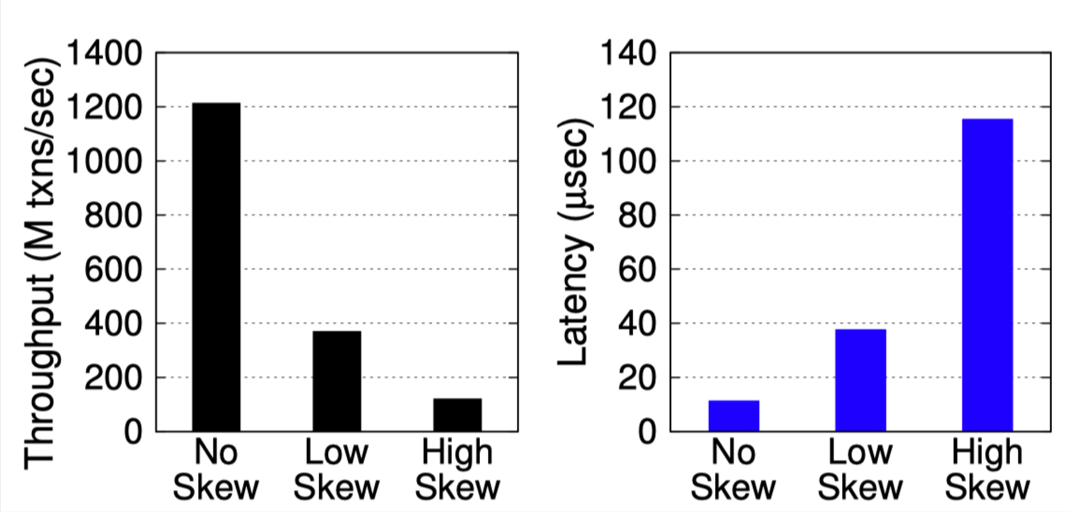
Performance Impact From Skewed Workloads
In-memory transaction systems are fast
Skewed workloads hurt performance
11X
3.3X
3.7X
10X

Slide 4
Performance Impact From Skewed Workloads
A simple example to illustrate imbalance
P0 P1 P2
N0
N1
Latency
P0 P1
50% 20%
P2 30%
Throughput

Slide 5
Solution: Live reconfiguration
Repartition database to balance workload
Generating partition plan is fast
How to lively migrate data?
Post-copy
Pre-copy
N0
N1
P0 P1
50% 20%
P2 30%
P1
Node 1

Slide 6
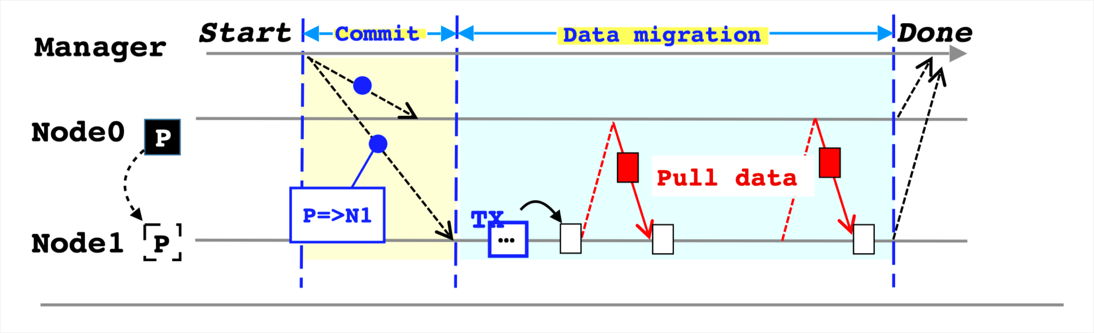
Sol#1: Migrating Data With Post-copy
E-store uses Squall to migrate data
1. Commit Plan first
2. Pull data on demand

Slide 7
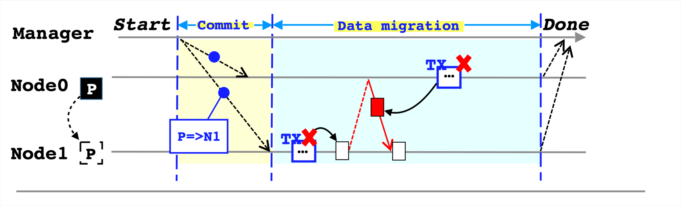
Sol#1: Migrating Data With Post-copy
E-store uses Squall to migrate data
Blocked by missing data
Aborted by migrated data

Slide 8
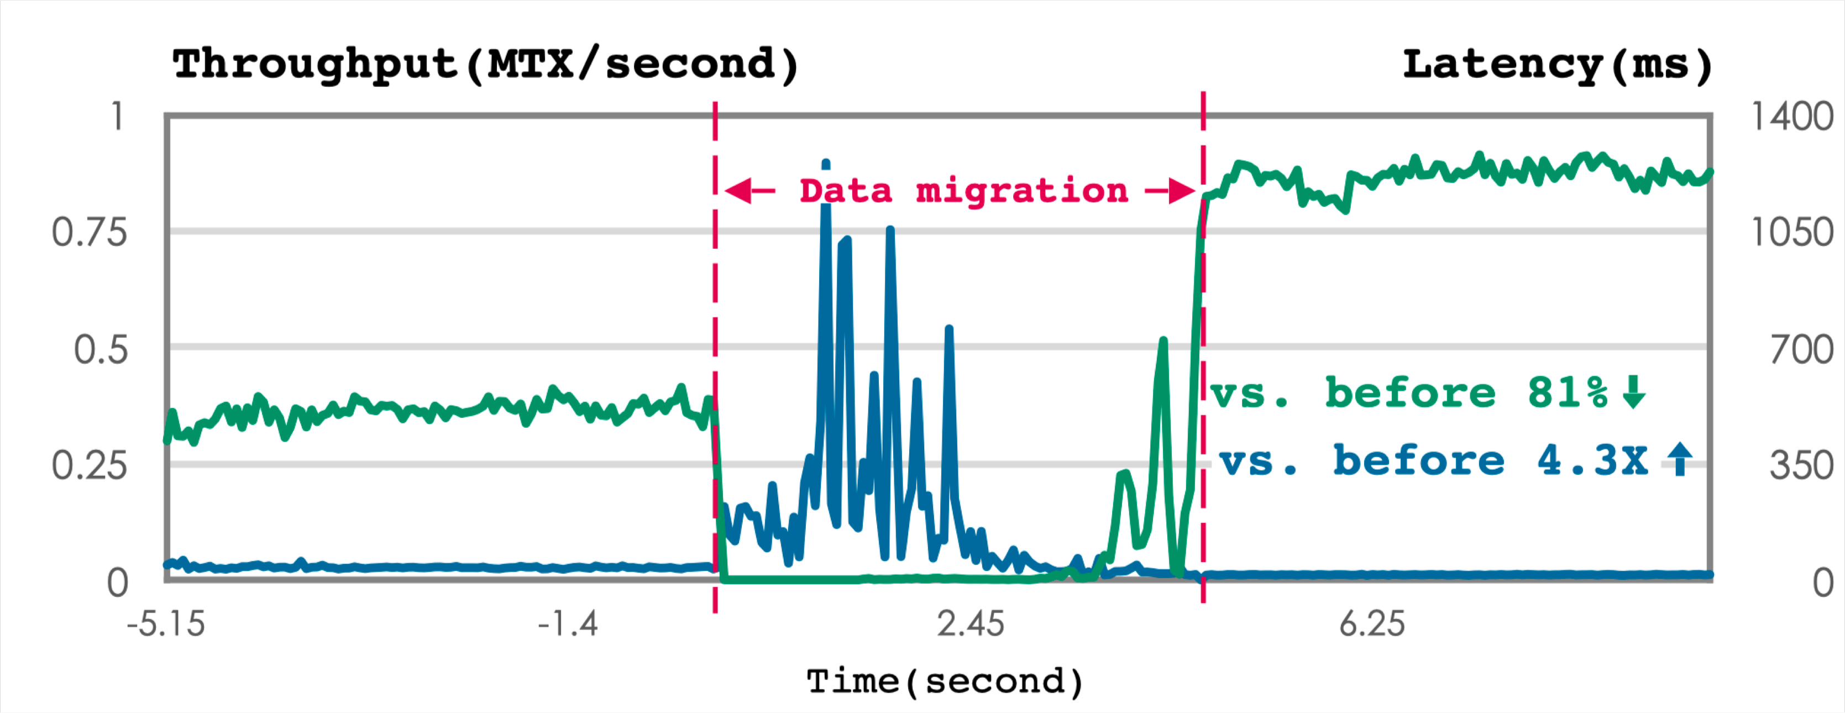
Sol#1: Post-copy Is Not suitable For Fast TXs
Takes about 4 secs to finish

Slide 9
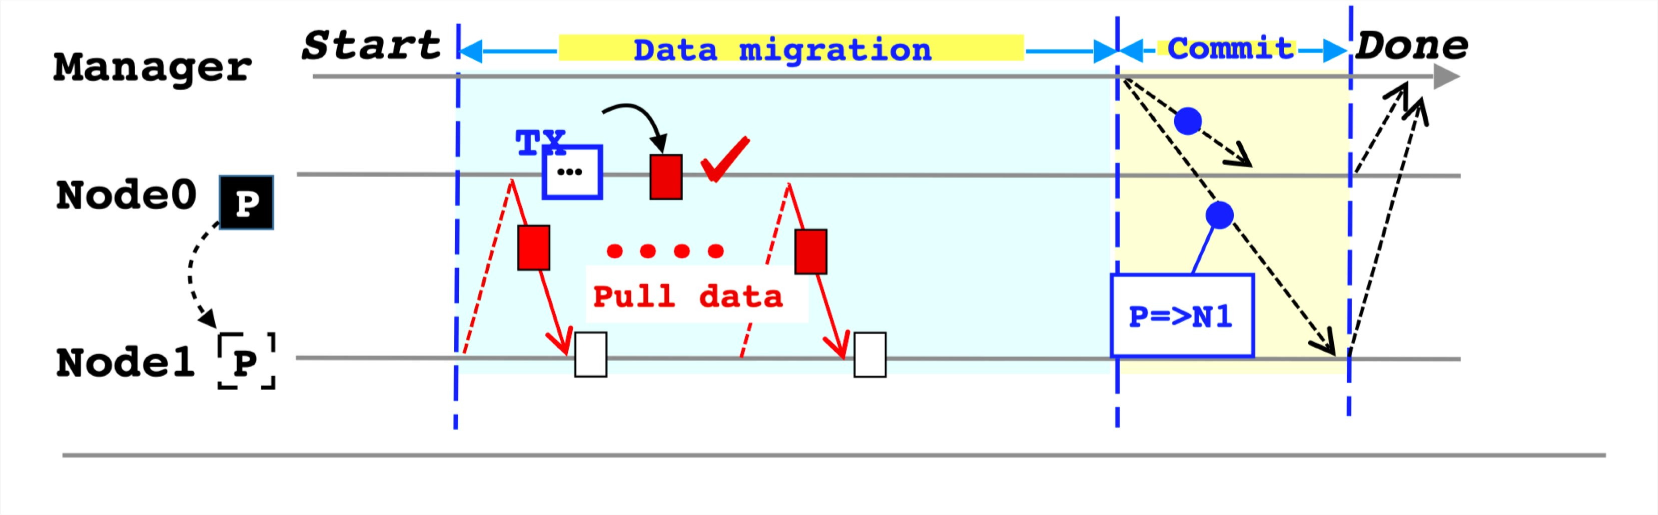
Sol#2: Migrating Data With Pre-copy
Same thought as virtual machine migration
1. Pull data asynchronously (not block TX)
2. Commit the plan

Slide 10
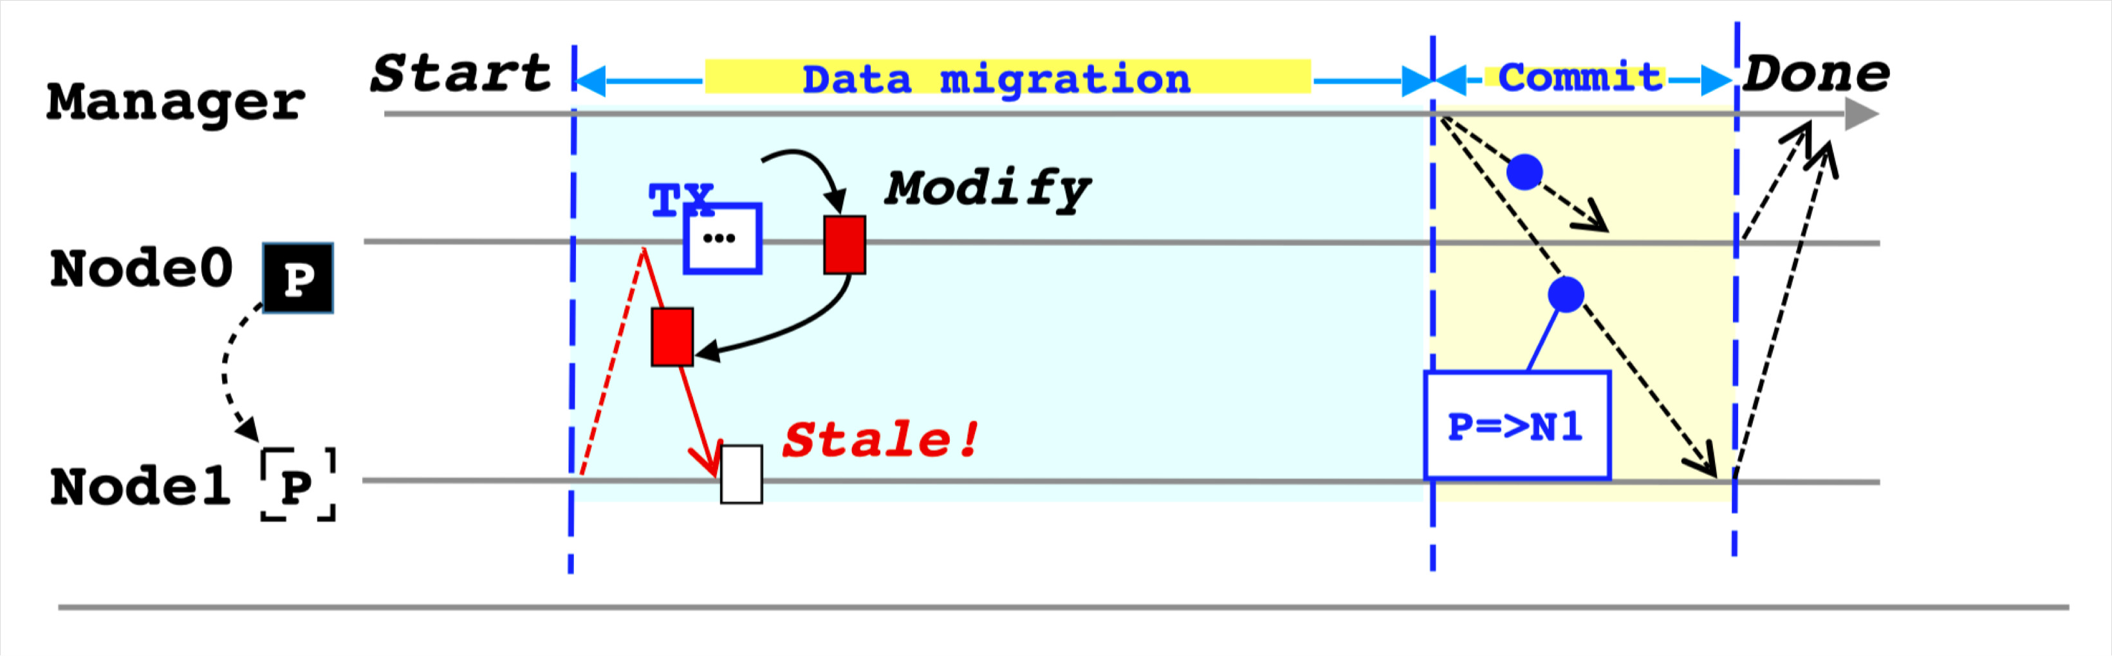
Sol#2: Pre-copy Is Not Free
Requires tracking & syncing dirty data

Slide 11
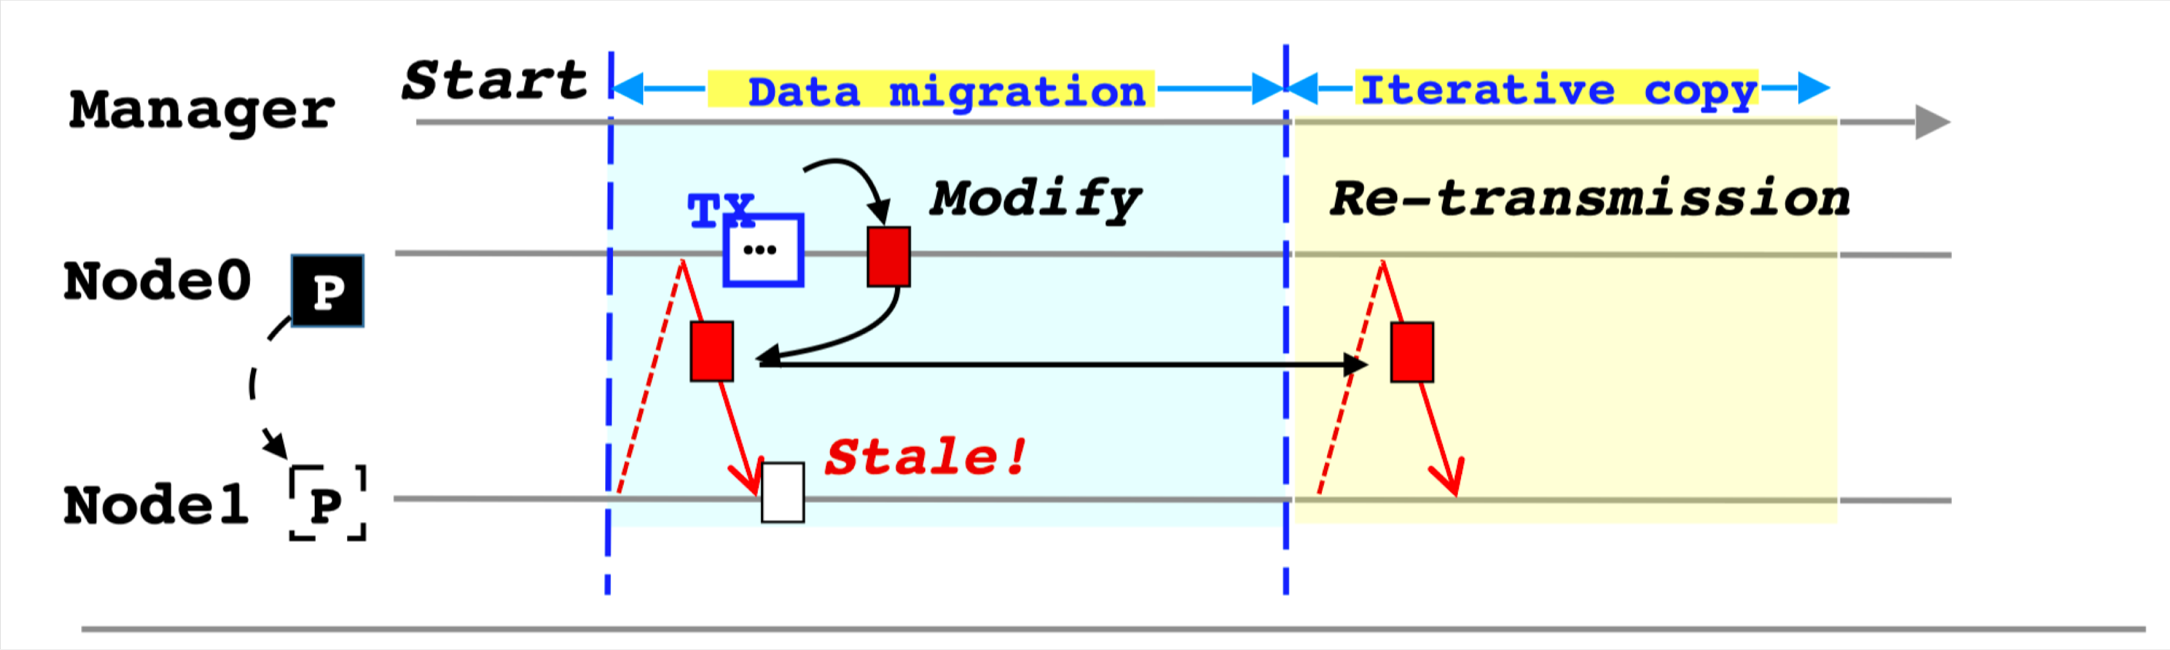
Sol#2: Pre-copy Is Not Free
Requires tracking & syncing dirty data
Longer migration time
Larger data transmissions

Slide 12
Outlines
System Architecture & Observations
Key Ideas
Improve pre-copy with log forwarding
Evaluations

Slide 13
Outlines
System Architecture & Observations
Key Ideas
Improve pre-copy with log forwarding
Evaluations

Slide 14
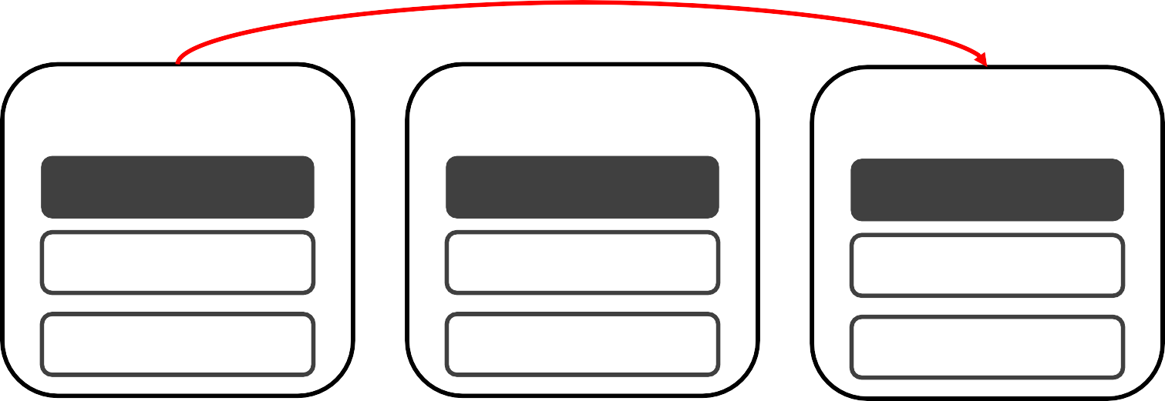
System Architecture & Observations
Sharded & replicated memory store
DrTM+R, FaRM and FaSST
Primary-backup synced with TX’s logs
Multiple backup
Log forward
^{ing} TX Log
N0 | N1 | N2
P0 | P1 | P2
P1 | P0 | P0
P2 | P2 | P1

Slide 15
Key Idea
Avoids possible data migration by preferring existing data replicas
Is almost enough for most skewed workload
Pre-copy based approach: minimizing costs
Leveraging existing fault tolerance mechanisms, i.e logging

Slide 16
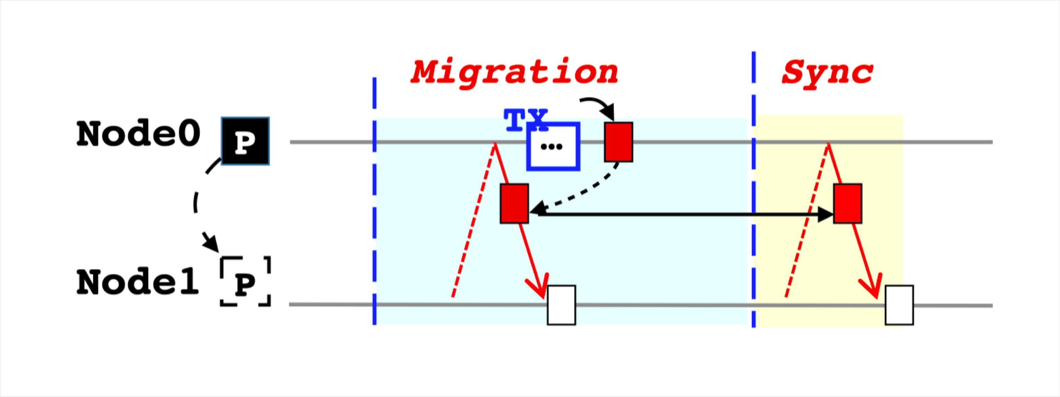
Improve pre-copy with log forwarding
Pre-copy requires tracking & syncing dirty data during migration

Slide 17
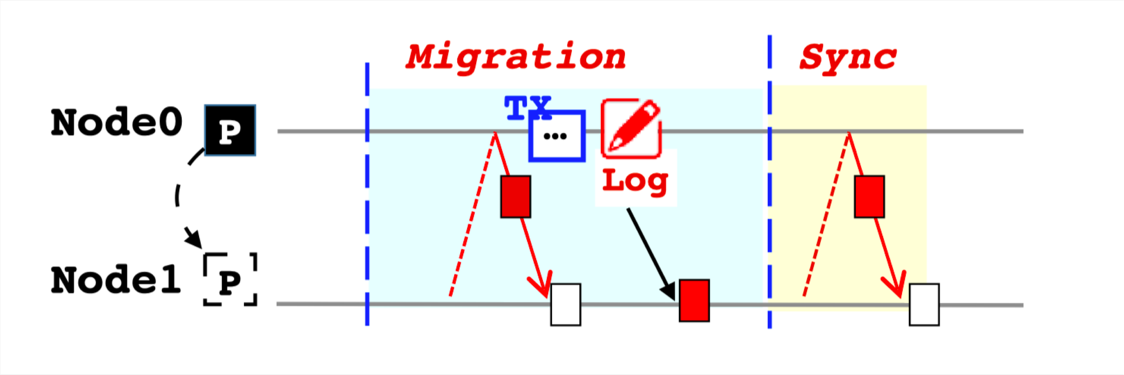
Improve pre-copy with log forwarding
Pre-copy requires tracking & syncing dirty data during migration
Reuse TX Log mechanism of fault tolerance
Apply Log

Slide 18
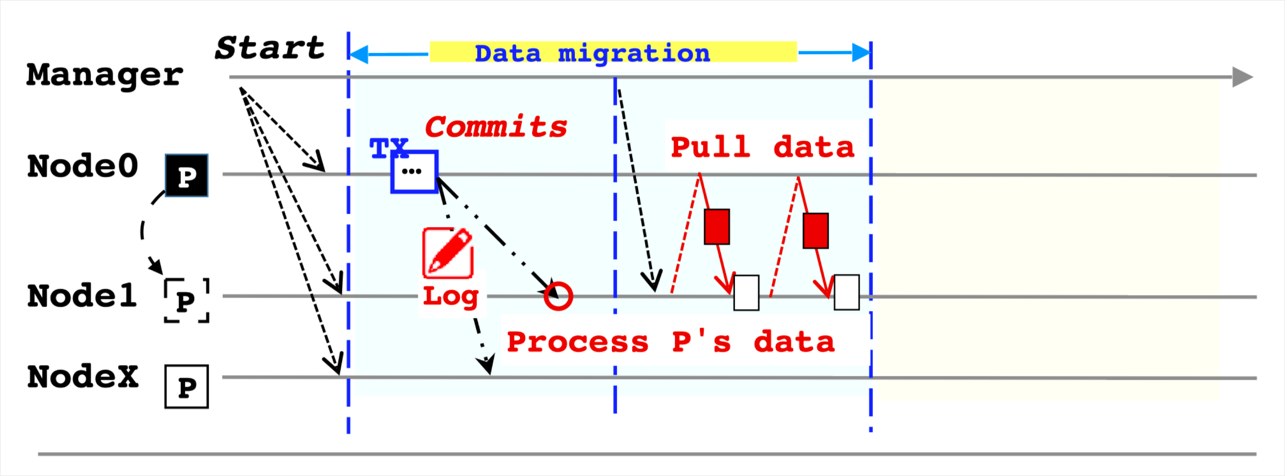
Data migration phase
Notify all nodes the new plan
Forwarding logs to destination
Pull data from source

Slide 19
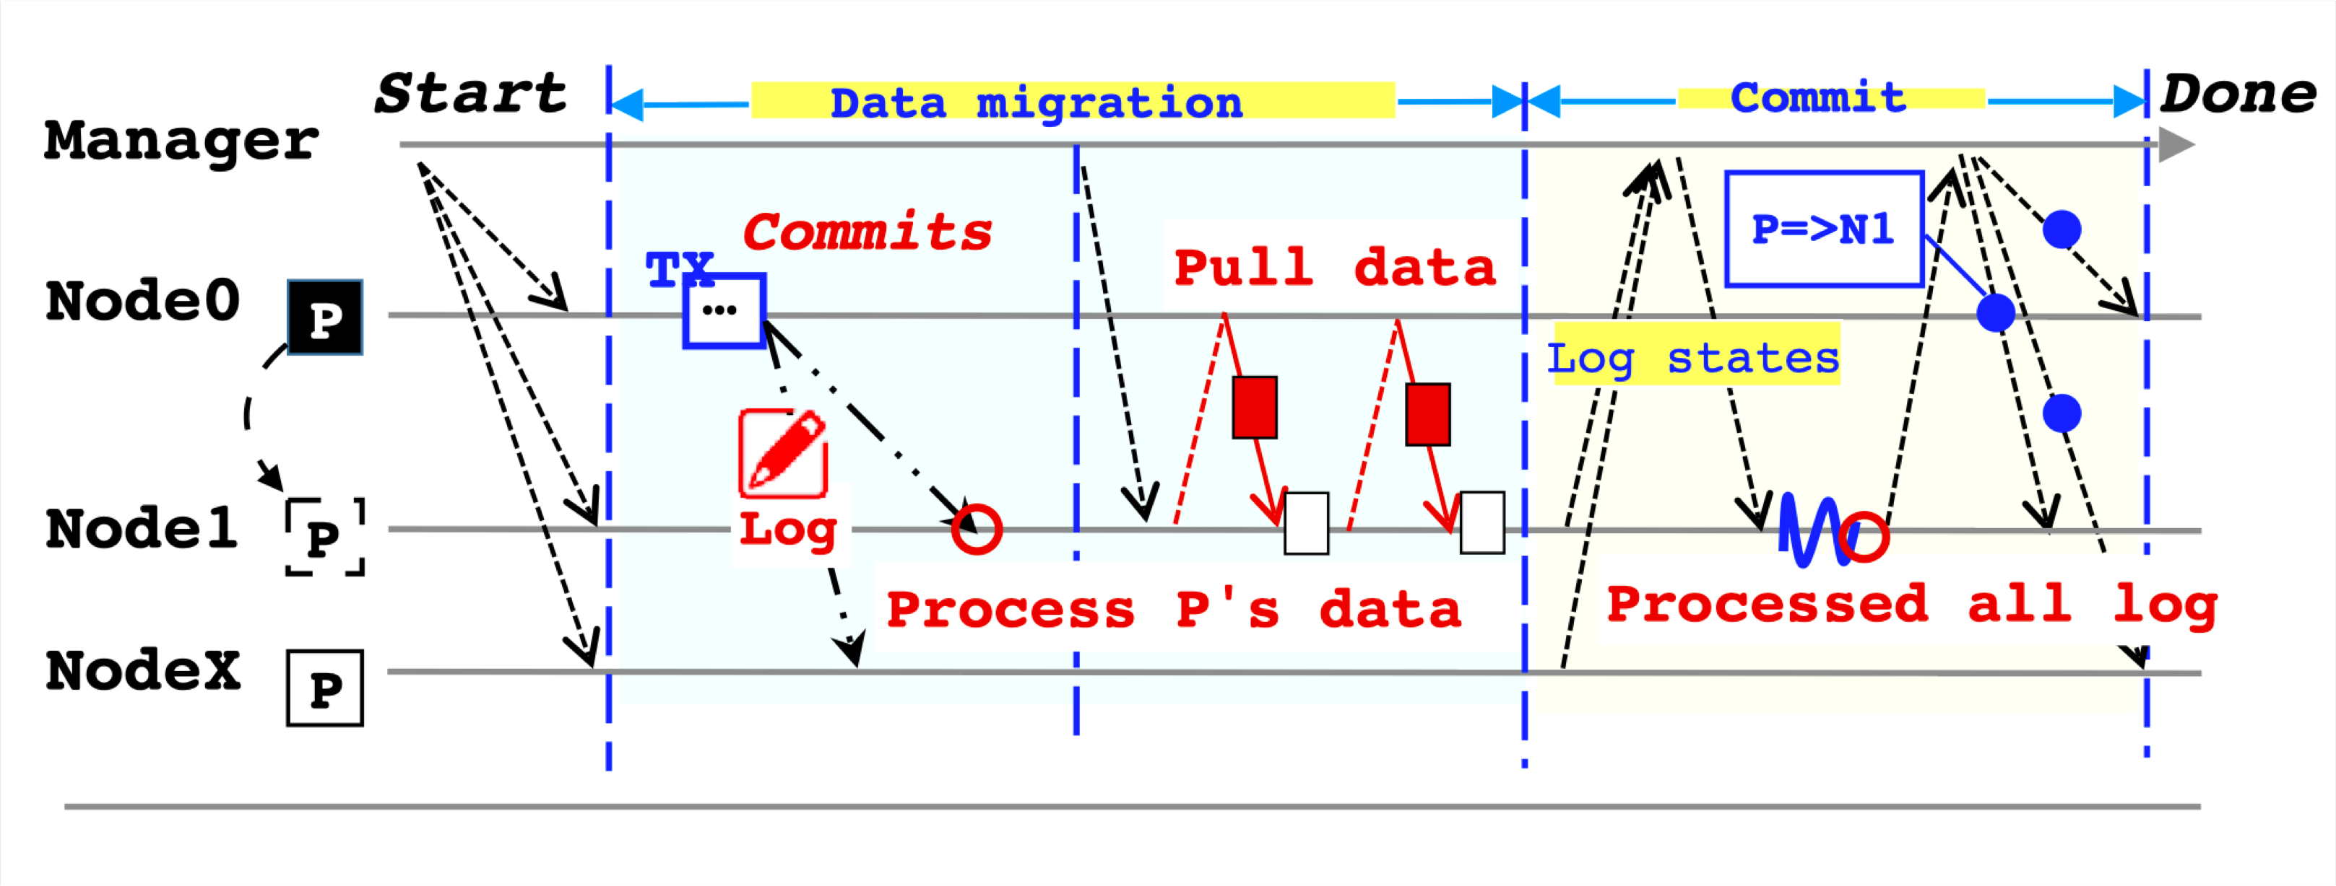
Commit phase
Collect log offsets
Wait for all pending logs to be processed
Commit the new plan

Slide 20
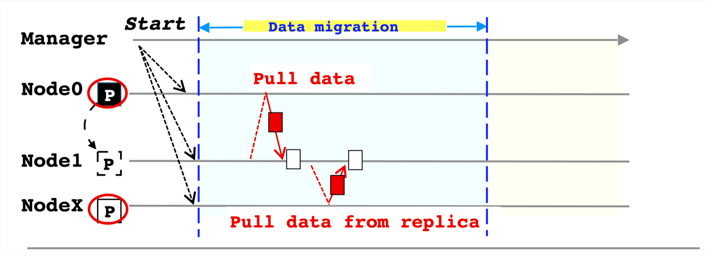
Furthermore: Parallel Data Fetching

Slide 21
Evaluations
Environment:
6-node local cluster
3-way replication enabled
Benchmarks:
TPC-C with 2 skewed settings
Comparison:
Post-copy on DrTM+R

Slide 22
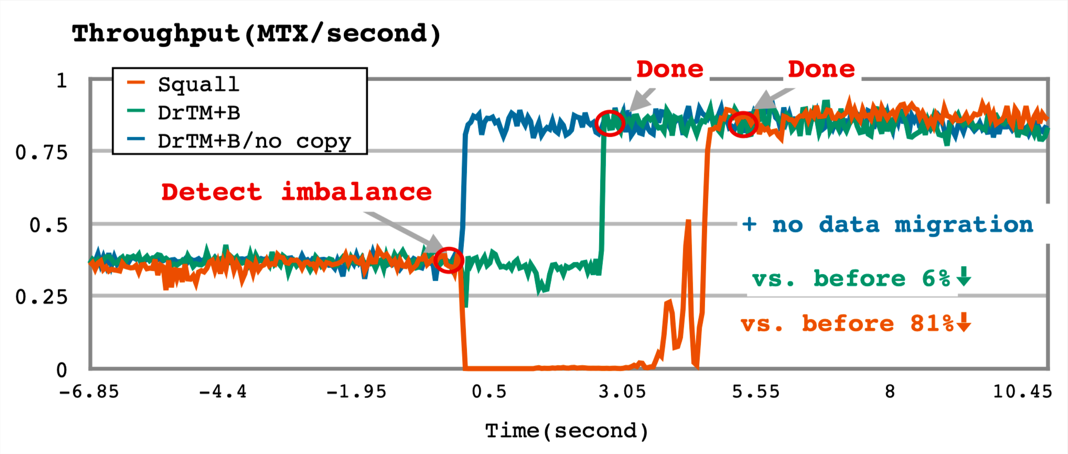
TPC-C in Low Skew
2.1X
2.5 secs
4.7 secs

Slide 23
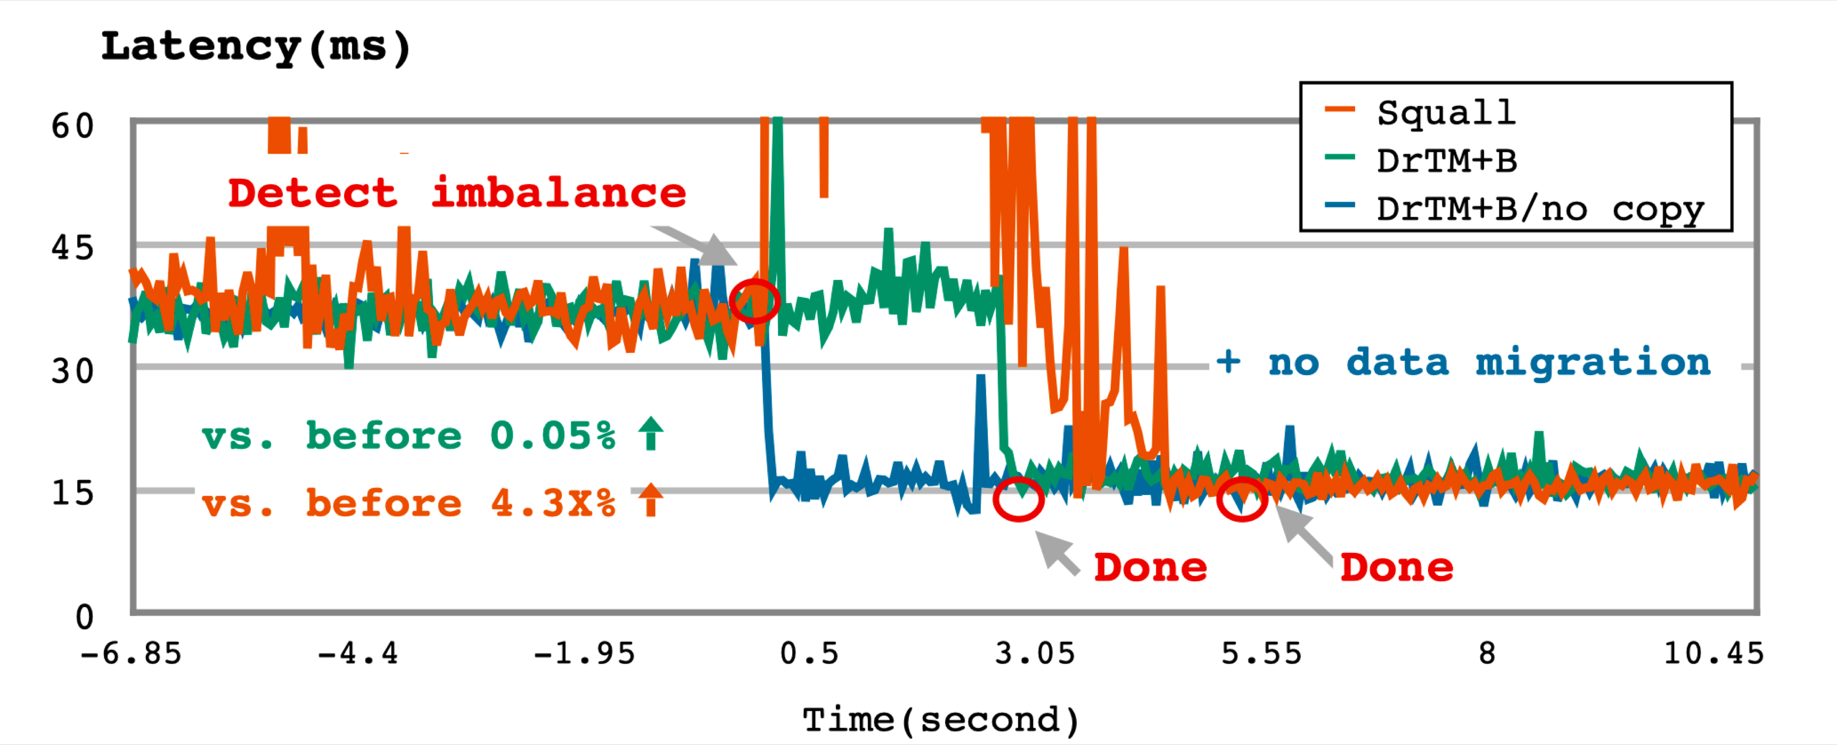
TPC-C in Low Skew
33 %

Slide 24
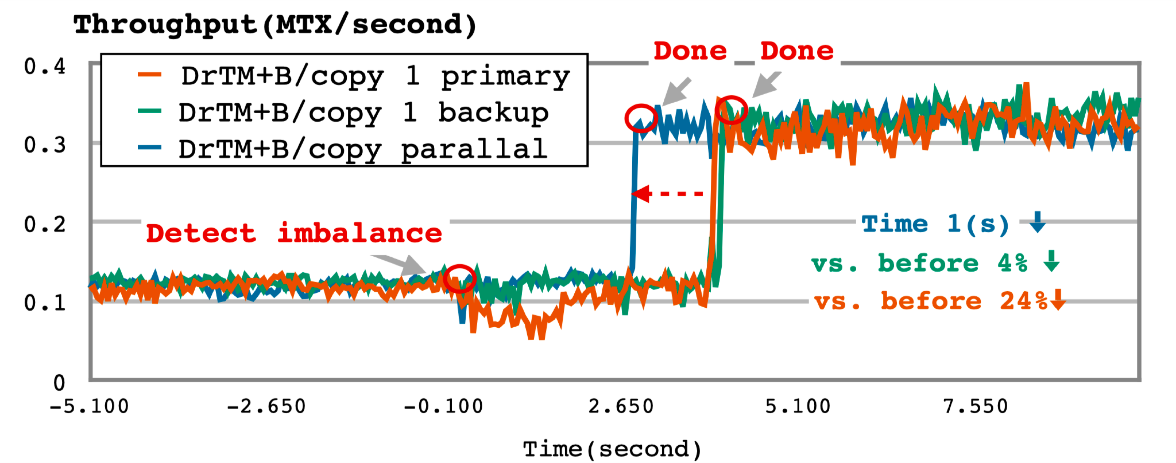
Optimization for Replication Copy(In High Skew)
3.0X
2.6 secs
3.5 secs

Slide 25
Conclusion
Real workloads are dynamic & skewed
Requires fast & seamless live reconfiguration
DrTM+B provides fast live reconfiguration
By reusing the fault tolerance mechanism

Slide 26
Thanks & Questions?

